Slide 1

Life Style Store - Web Application
Detailed Developer Report

Slide 2
Security Status :- Extremely Vulnerable
Hacker can steal all records from database of website. (SQLi)
Hacker can take control of complete server including view, add, edit, delete, files and folders. (Shell Upload)
Hacker can change the source code of application to host malware, Phishing pages or even explicit content. (Shell upload)
Hacker can inject client side code into the application and trick users by changing how a page looks to steal the information or the name of company. (XSS)
Hacker can extract order details of all the customers. (IDOR)
Hacker can execute any command to extract any information from the website and deface it. (Admin panel access)
Hacker can easily view default debug pages can easily guess the default passwords. hackers exploit these default files which further helps them to plan their attacks.(server misconfigurations)

Slide 3

1
Critical
18
Vulnerabilty status
2
Severe
8
3
Moderate
2
4
low
6

Slide 4
Vulnerabilities -
No. | Severity | vulnerabilities | Count
1) | Critical | SQL injections | 4
2) | Severe | Reflected and stored cross site scripting | 2
3) | Moderate | PII leakage | 1
4) | Severe | Open redirection | 1
5) | Critical | Insecure direct object reference(IDOR) | 3
6) | Moderate | Client side filter bypass | 1
7) | Critical | Rate limiting flaws | 2
8) | Critical | Insecure file upload | 2
9) | Severe | Forced Browsing | 2

Slide 5
No. | Severity | vulnerabilities | Count
10) | Low | Descriptive error messages | 1
11) | Critical | Remote file inclusion | 1
12) | Low | Default Files and Pages | 5
13) | Critcal | Components with known vulnerabilities | 3
14) | Severe | Bruteforce Exploitation of Coupon Codes | 1
15) | Critical | Command Execution Vulnerability | 2
16) | Severe | Cross-site request forgery | 2
17) | Critical | Weak Passwords | 1

Slide 6
1) SQL injection :-
SQL Injection (critical) | Below mentioned url in the online e-commerce portal is vulnerable to sql injection attack. Affected Url http://35.154.84.159/products.php?cat=1 Affected parameter cat = 1 (GET parameter) Payload cat = 1’

Slide 7
1) SQL injection :-
SQL Injection (critical) | here are some other SQLi in web application. Affected Url https://35.154.84.159/products.php?cat=2 https://35.154.84.159/products.php?cat=3

Slide 8
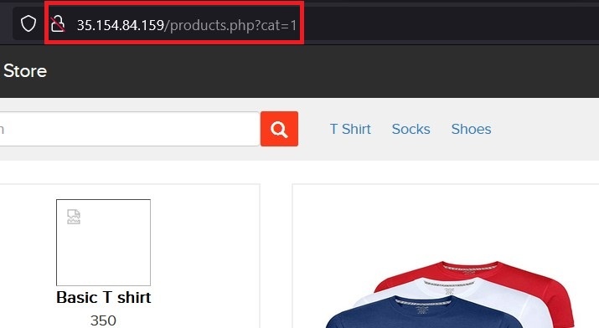
Observation
Nevigate to shop now button where you can see the categories option. Now click on the “T shirts” or “socks” or “shoes” to get into this url, you will see the products as per the category you have selected but notice the GET parameter in Url.

Slide 9
Observation
Now we can apply single quote to cat parameter (GET parameter)
http://35.154.84.159/products.php?cat=1’ which gives an MySQL error

Slide 10
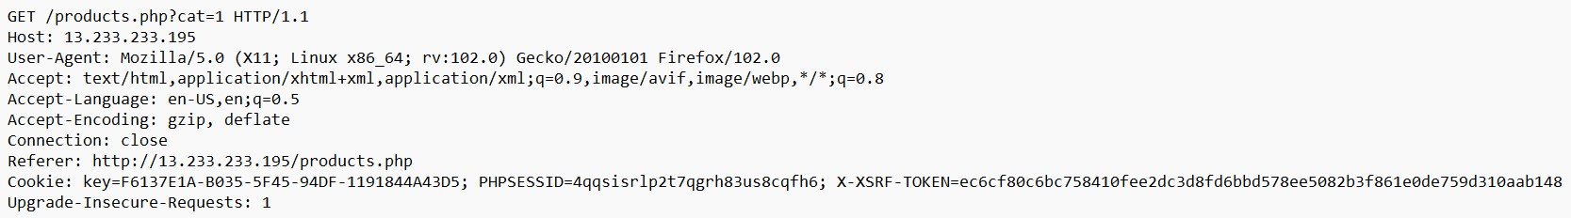
Proof of concept(POC)
Now by using request intercepted by burp suit an attacker an execute sqlmap commands to extract the data

Slide 11
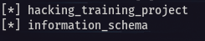
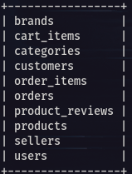
POC :- Attacker can dump arbitrary data
No of databases: 2
hacking_training_project
information_schema
No of tables in hacking_training_project : 10
brands
cart_items
categories
customers
order_items
orders
product_reviews
products
sellers
users

Slide 12
1) SQL injection :-
SQL Injection (critical) | Below mentioned url in the online e-commerce portal is vulnerable to sql injection attack. Affected Url https://43.205.217.41/products.php?page=2 Affected parameter cat = 1 (POST parameter) Payload cat = 1’

Slide 13
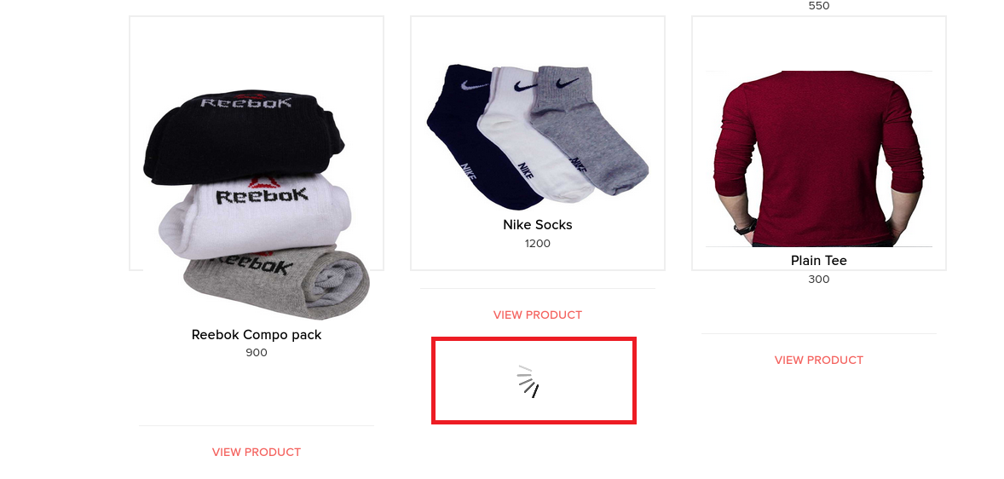
Observation
Navigate to the shop now button and if you scroll down there is process of autoloading of products.

Slide 14
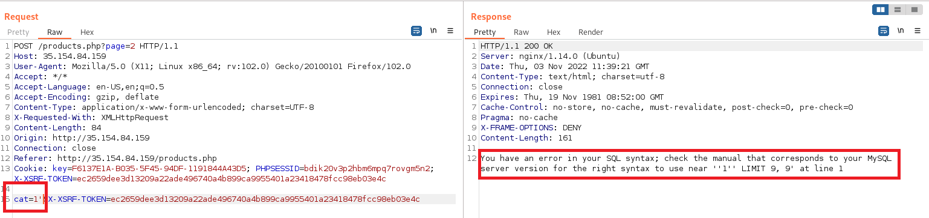
Observation
Now if you intercept the request with help of poxy server then SQL injection is possible in the “cat” parameter as shown below

Slide 15
Proof of concept(POC)
Now by using request intercepted by burp suit at autoloading page an attacker an execute sqlmap commands to extract the data
POST /products.php?page=2 HTTP/1.1
Host: 43.205.217.41
User-Agent: Mozilla/5.0 (X11; Linux x86_64; rv:102.0) Gecko/20100101 Firefox/102.0
Accept: */*
Accept-Language: en-US,en;q=0.5
Accept-Encoding: gzip, deflate
Content-Type: application/x-www-form-urlencoded; charset=UTF-8
X-Requested-With: XMLHttpRequest
Content-Length: 82
Origin: http://43.205.217.41
Connection: close
Referer: http://43.205.217.41/products.php
Cookie: key=F6137E1A-B035-5F45-94DF-1191844A43D5; PHPSESSID=6c6lj5r7uoak5kg6meinjjs3g6; X-XSRF-TOKEN=6496b16238d4a0b09f48faff68e21dd84d9684714f3d19fe66b2a520f983ed8f
cat=&X-XSRF-TOKEN=6496b16238d4a0b09f48faff68e21dd84d9684714f3d19fe66b2a520f983ed8f

Slide 16
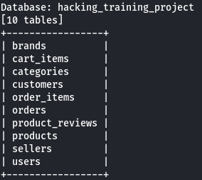
PoC – Attacker can dump arbitrary data
No of databases: 2
hacking_training_project
information_schema
No of tables in hacking_training_project : 10
brands
cart_items
categories
customers
order_items
orders
product_reviews
products
sellers
users

Slide 17
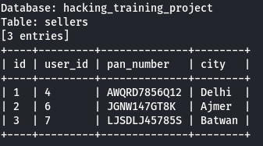
Business Impact – Extremely High
using this vulnerabiltiy attacker can execute arbitarary sql commands on lifestyle store and gains the complete access to the internal database.
Below is the screenshot of users table which shows user credentials being leaked, although the password is encrypted yet vulnerable and can be misused by hackers.
Attacker can gain the access to the admin panel by using below credentials which could lead the complete compromise of server and all the other servers connected to it.

Slide 18
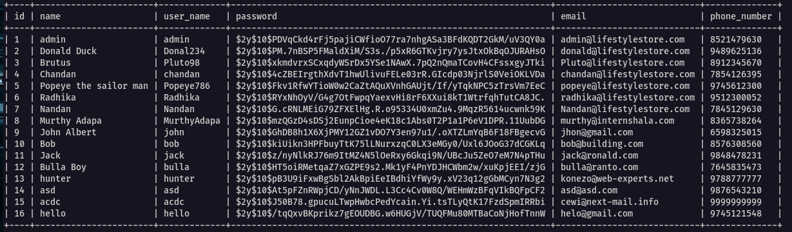
Business Impact – Extremely High

Slide 19
Recommendation
Take the following precautions to avoid exploitation of SQL injections:
Prepared Statements: Use SQL prepared statements available in all web development languages and frameworks to avoid attacker being able to modify SQL query.
Character encoding: If you are taking input that requires you to accept special characters, encode it. Example. Convert all ‘ to \’ , “ to \”, \ to \\. It is also suggested to follow a standard encoding for all special characters such has HTML encoding, URL encoding etc
Do not run Database Service as admin/root user
Disable/remove default accounts, passwords and databases
Assign each Database user only the required permissions and not all permissions

Slide 20
References
https://www.owasp.org/index.php/SQL_Injection
https://en.wikipedia.org/wiki/SQL_injection

Slide 21
2) Reflected Cross Site Scripting(XSS)
Cross Site Scripting (Severe) | Below mentioned parameters are vulnerable to reflected XSS, Affected URL http://35.154.84.159/search/search.php?q=( here) Affected Parameters q Payload “><script>alert(1)</script>

Slide 22
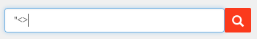
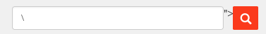
Observation
Click on SHOP NOW button and type “<> in the Search Box.
You will notice that the code being reflected on the website.

Slide 23
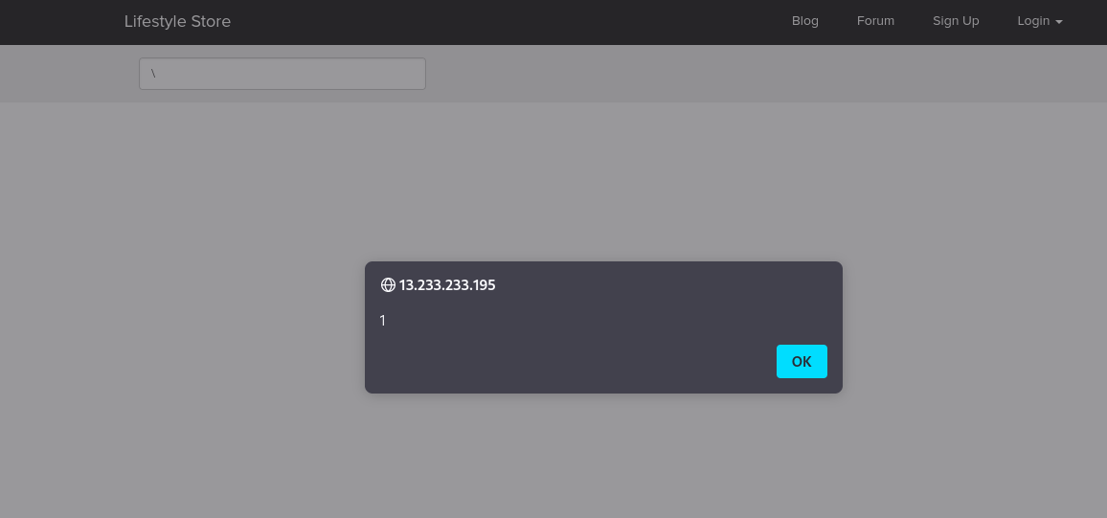
PoC – custom script is executed
Now, put the payload instead of “<> after the parameter q or in the search box : “><script>alert(1)</script>
as you can see JS code is executed which cause the popup window.

Slide 24
2. Stored Cross Site Scripting (XSS)
Cross Site Scripting (Severe) | Below mentioned parameters are vulnerable to stored XSS, Affected URL http://35.154.84.159/products/details.php?p_id=(all id’s) Affected Parameters customer review text field Payload <script>alert(1)</script>

Slide 25
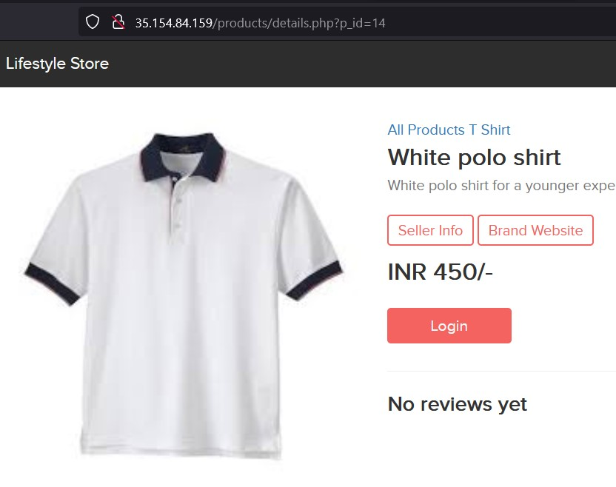
Observation
Click on SHOP NOW button and select any product, Or Navigate to http://13.232.162.26/products/details.php?p_id=14.

Slide 26
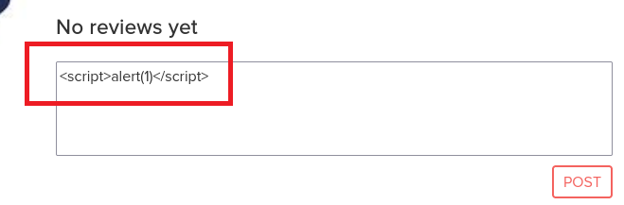
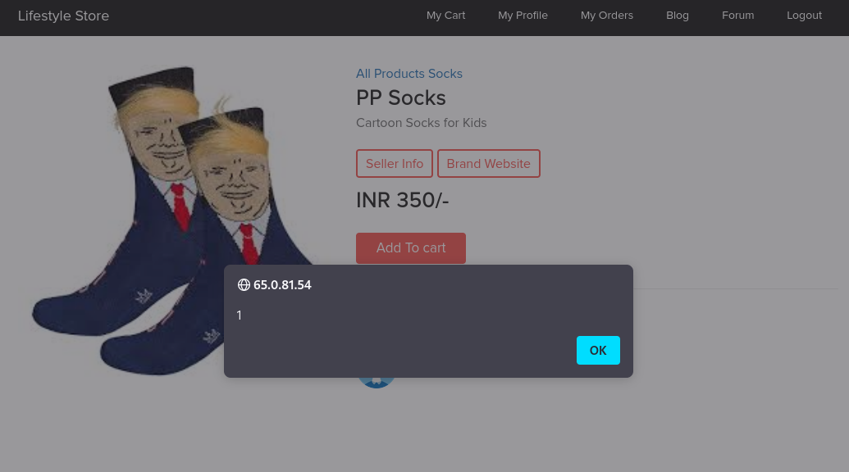
PoC – the script was executed
login to customer account and put the payload as a customer review in the review field: <script>alert(1)</script> As you can see we executed custom JS causing popup.

Slide 27
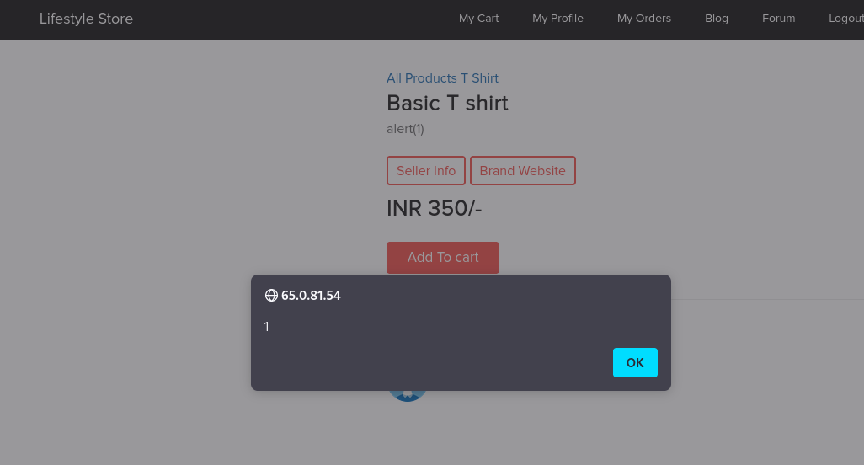
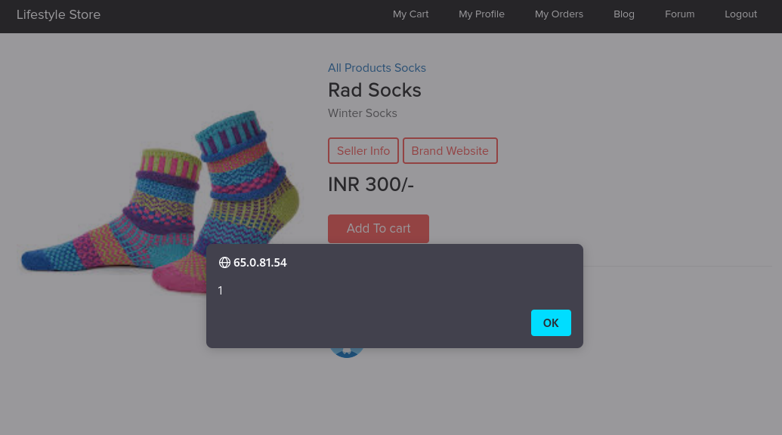
PoC

Slide 28
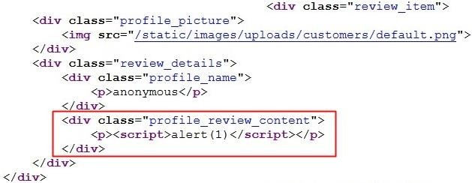
Business Impact – High
As an attacker inject arbitrary HTML , CSS and JavaScript via review text field attacker can put any content on the page like phishing pages, install malware on victims device and even host the explicit content that could compromise the reputation of organization
An attacker needs to do is to type malcious script on review field and then anyone opening the link can be attacked by hacker and victim could see the hacker controlled website .

Slide 29
Recommendation
Take the following precautions:
Sanitize all user input and block characters you do not want.
Convert special HTML characters like ‘ “ < > into HTML entities &quot; %22 &lt; &gt;
before printing them on the website.

Slide 30
References
https://owasp.org/www-community/attacks/xss/
https://en.wikipedia.org/wiki/Cross-site_scripting

Slide 31
3. PII Leakage
PII Leakage (Moderate) | Below mentioned URL is vulnerable to personnel identifiable information leakage. Affected URL : http://35.154.84.159/products/details.php?p_id=(any product id)

Slide 32
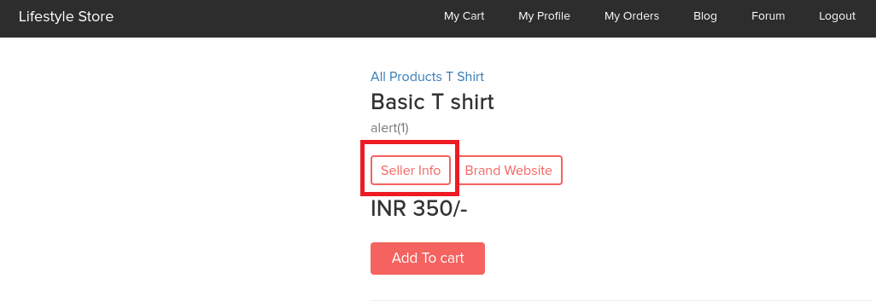
Observation
Navigate to shop now button and click on view product of any product.
In every product page the Seller Info is available, click on it.

Slide 33
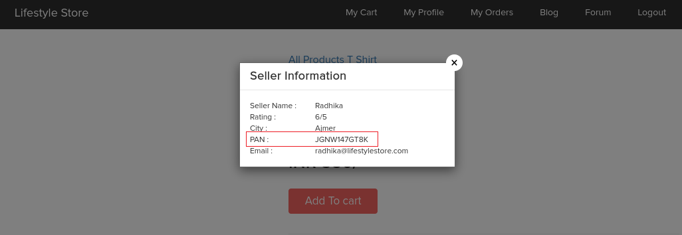
PoC – pan card details are shown
Upon clicking on Seller Info; Seller Name, Rating, City, Email along with PAN Card Details are shown.

Slide 34
Business Impact – High
Leaking critical information like pan card details to everyone is exposure of data to hackers. attacker can use this data to socially hack them.

Slide 35
Recommendation
Hide critical information like the PAN Card details.
Display only minimal required information about the sellers.

Slide 36
References
https://www.geeksforgeeks.org/personally-identifiable-information-leakage-vulnerability/
https://shahjerry33.medium.com/pii-leakage-revealing-secrets-8b617071bd1c

Slide 37
4.Open redirection
Open Redirection (Severe) | Below mentioned URL is vulnerable to open redirection. Affected URL http://35.154.84.159/redirect.php?url=www.radhikafancystore.com Affected Parameters url

Slide 38
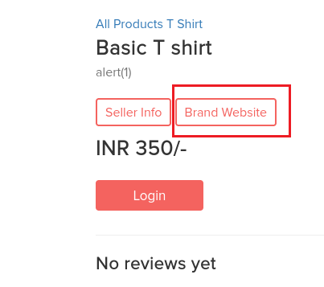
Observation
Navigate to shop now button and select any product and click on view product.
In every product page the Brand Website is available, click on it.

Slide 39
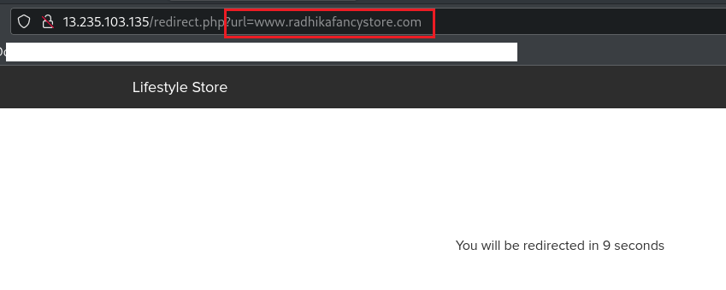
Observation
By clicking on Brand website we will be redirected to brand’s website

Slide 40
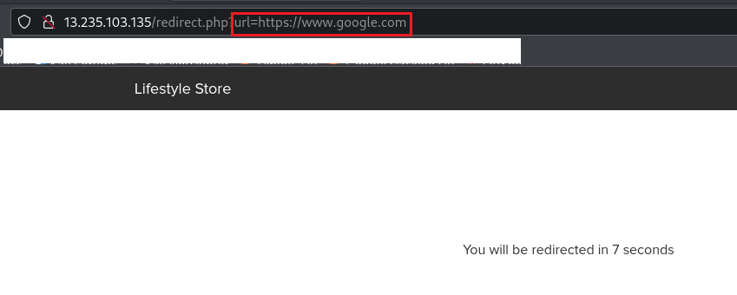
Observation
Now change the url of Brand website to some other website for example https://google.com

Slide 41
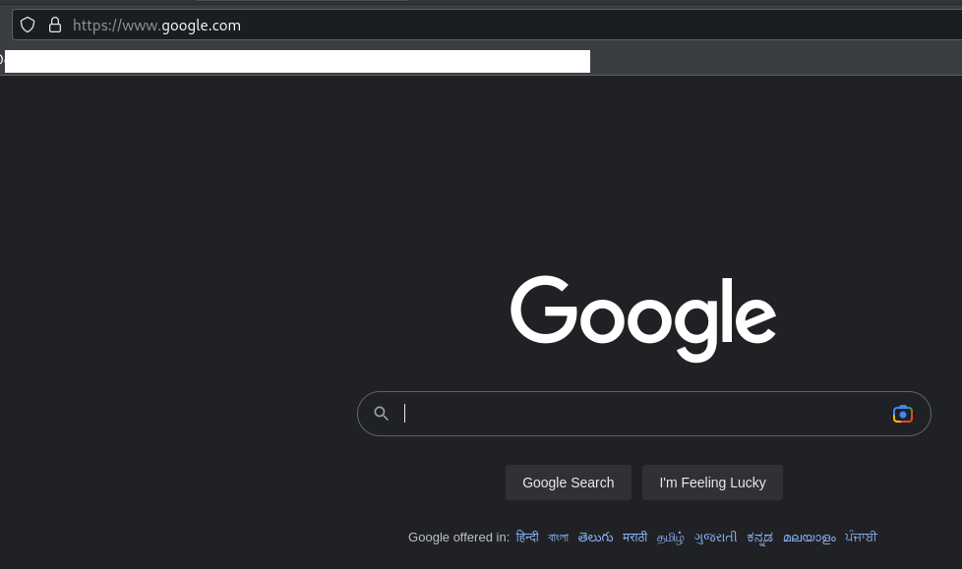
PoC – open redirection
By changing Url of brand website to some other website we are redirected to that website

Slide 42
Business Impact – High
The hacker can redirect your page to a malicious page or some other phishing sites.

Slide 43
Recommendation
Check your referrers
Design your web application to avoid URL redirects or forwards as best practice. If unavoidable, encrypt the
target URL such that the URL:token mapping is validated on the server.
Verify URL patterns using regular expressions to check if they belong to valid URLs. However, malicious URLs can pass that check.

Slide 44
References
1) https://spanning.com/blog/open-redirection-vulnerability-web-based-application-security-part-1/
2) https://portswigger.net/kb/issues/00500100_open-redirection-reflected

Slide 45
5) IDOR (Insecure direct object reference)
Insecure Direct Object Reference (Critical) | The My Orders section of the website suffers from an Insecure Direct Object Reference (IDOR) that allows attacker get access to other customers order details along with shipping details and payment modes. Affected URL http://35.154.84.159/orders/orders.php?customer=(all customer id’s) Affected Parameters : customer (GET parameters)

Slide 46
5) IDOR (Insecure direct object reference)
Insecure Direct Object Reference (Critical) | Similar issue is found on below modules too, Affected URL : http://13.127.165.218/products/details.php?p_id=(all id’s) http://35.154.84.159/forum/index.php?u=/user/profile/(any id) Affected Parameters : p_id (GET parameters) u=/user/profile/(any id)

Slide 47
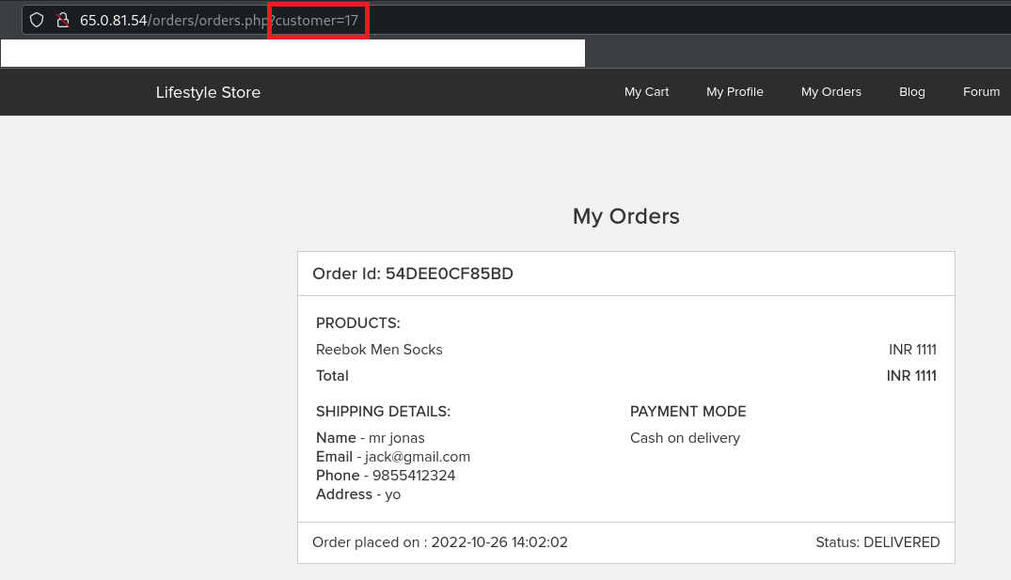
Observation
Login to your account and go to My
Orders section.
Your My Orders section will be shown to you.
Notice the URL : http://35.154.84.159/orders/orders.php?customer=17
It contains customer id of the user and we get the order details along with shipping details and payment mode of our user.

Slide 48
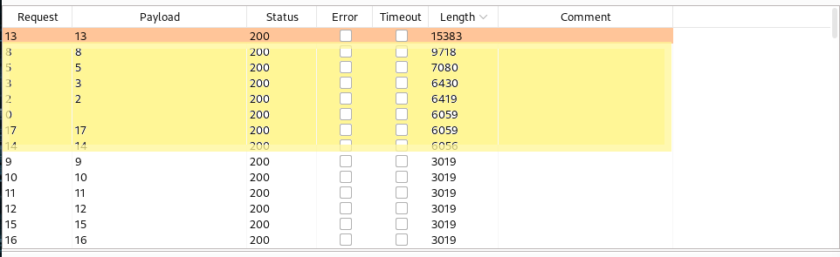
Observation
Since, the customer id is clearly visible, let’s intercept the request and brute force the customer id’s of all available customers.

Slide 49
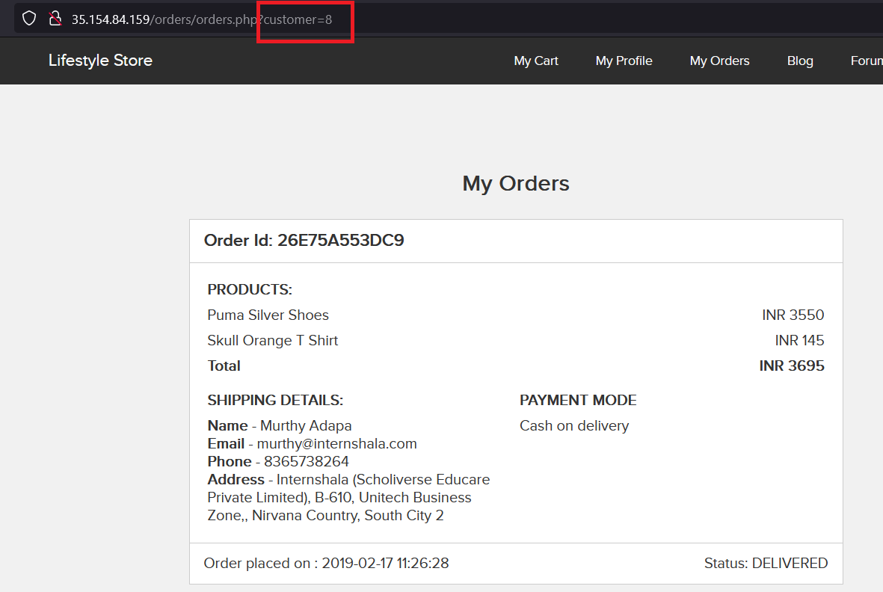
PoC – accessing other customer’s details
Now, we change the customer id to 8.
We get the order details along with shipping details and payment mode of other customers(here the user with customer id = 8).

Slide 50
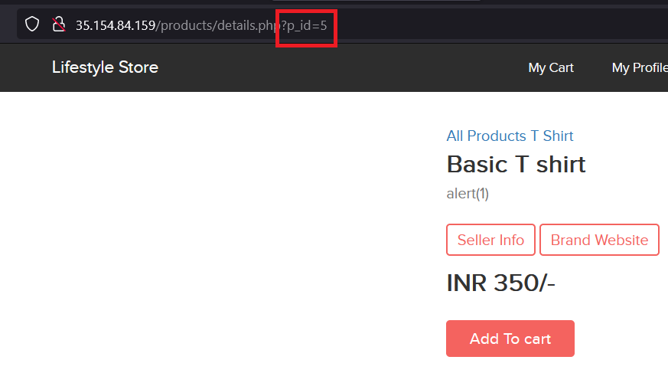
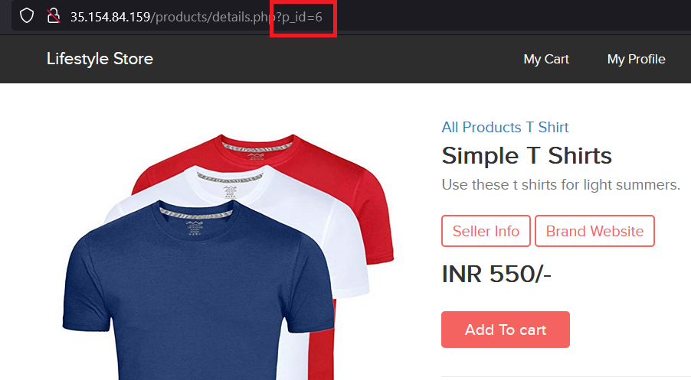
PoC
Just by changing the product id, other products can be seen.

Slide 51
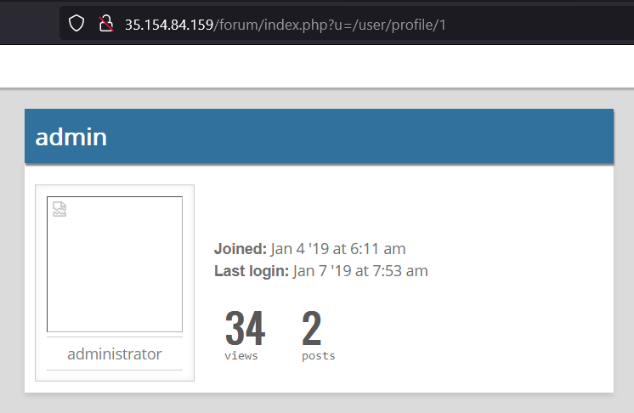
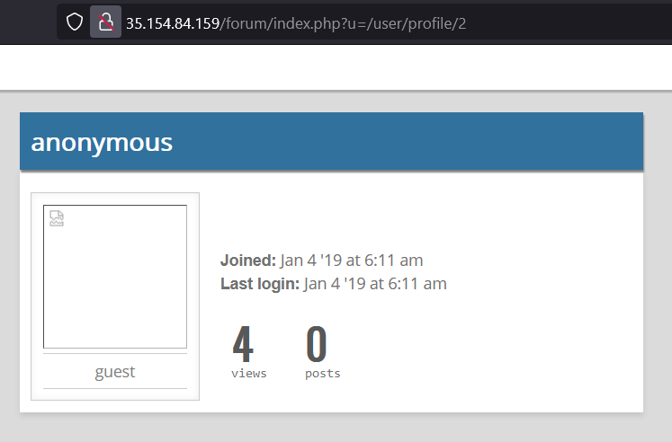
PoC
Just by changing the profile id, other user’s profile can be seen.

Slide 52
Business Impact – Extremely High
A malicious hacker can read order information of any user just by knowing the customer id. This discloses critical order information of users including:
Name
Mobile Number
Email Address
Physical Address
Order Id
Bill Amount and Breakdown
Payment Mode
This can be used by malicious hackers to carry out targeted phishing attacks on the users and the information can also be sold to competitors/black-market.
More over, as there is no rate limiting checks, attacker can brute force the customer id for all possible values and get bill information of each and every user of the organization resulting is a massive information leakage.

Slide 53
Recommendation
Take the following precautions:
Make sure each user can only see his/her data only.
Use proper rate limiting checks on the number of request comes from a single user in a small
amount of time.
Implement proper authentication and authorization checks to make sure that the user has permission to the data he/she is requesting.

Slide 54
References
https://www.owasp.org/index.php/Insecure_Configuration_Management
https://www.owasp.org/index.php/Top_10_2013-A4- Insecure_Direct_Object_References

Slide 55
6) Client Side Filter Bypass
Client Side Filter Bypass (Moderate) | Below mentioned URL is vulnerable to client side filter bypass. Affected URL : http://13.232.112.210/profile/16/edit/

Slide 56
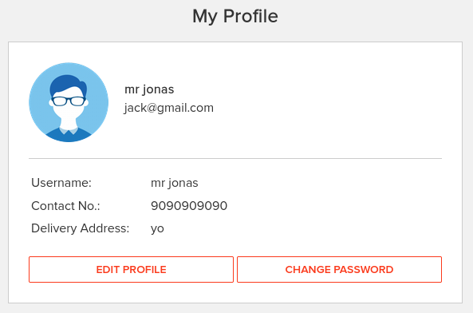
Observation
Login to your account and go to My Profile section.
Now, click on edit profile button, update any of your details, here I will go with phone number only.
I updated my phone number from 9876543211 to 9090909090.
Now, again click on UPDATE button and intercept the request with Burp Suite.

Slide 57
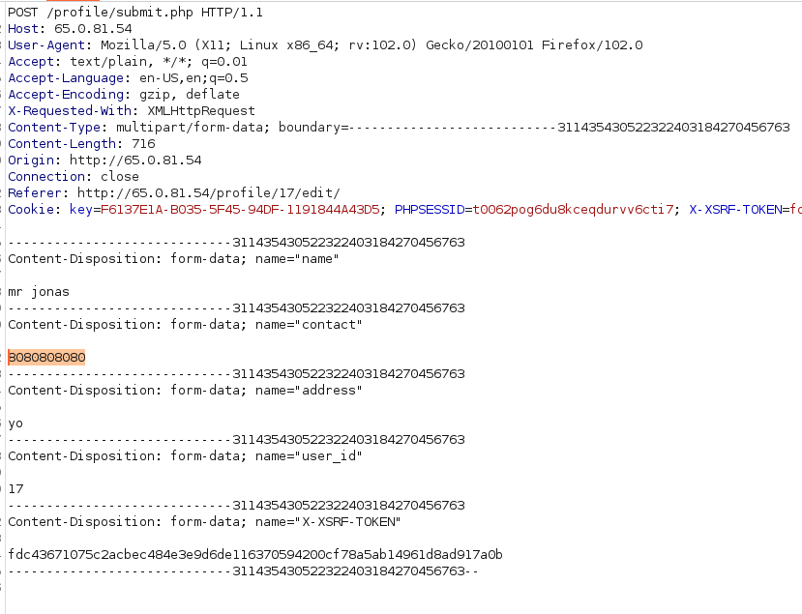
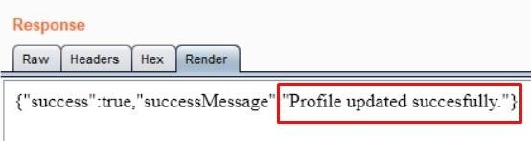
Observation
Now, send the request to the Repeater and edit the phone number.
I changed it from 9090909090 to 8080808080 and hit Send.

Slide 58
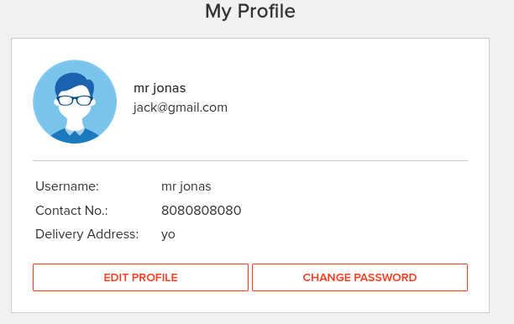
PoC – profile updated successfully
As you can see Contact No. has been changed.

Slide 59
Business Impact – High
This would only trouble the users who in turn might give negative feedback on your website.

Slide 60
Recommendation
Implement all critical checks on server side code .
Client-side checks must be treated as decorative .
All business logic must be implemented and checked on the server code. This includes user input, the flow of applications and even the URL/Modules a user is supposed to access or not.

Slide 61
References
https://portswigger.net/support/using-burp-to-bypass-client-side-javascript-validation
https://www.slideshare.net/SamBowne/cnit-129s-ch-5-bypassing-clientside-controls

Slide 62
7) Rate Limiting Issues
Account Takeover Using OTP Bypass (Critical) | the below mentioned signup page allows attacker to create large no. of signup’s Affected URL http://13.232.112.210/signup/customer.php Affected Parameters customer signup

Slide 63
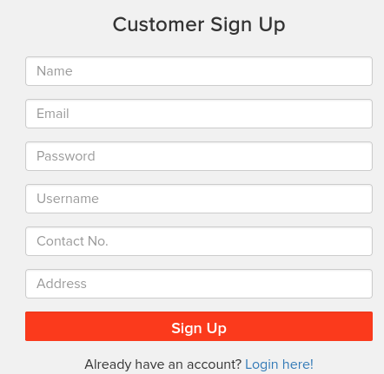
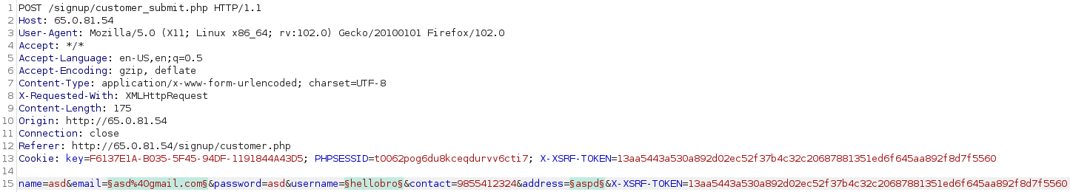
POC
After filling the information in the signup page click on sign Up intercept the request with proxy server.

Slide 64
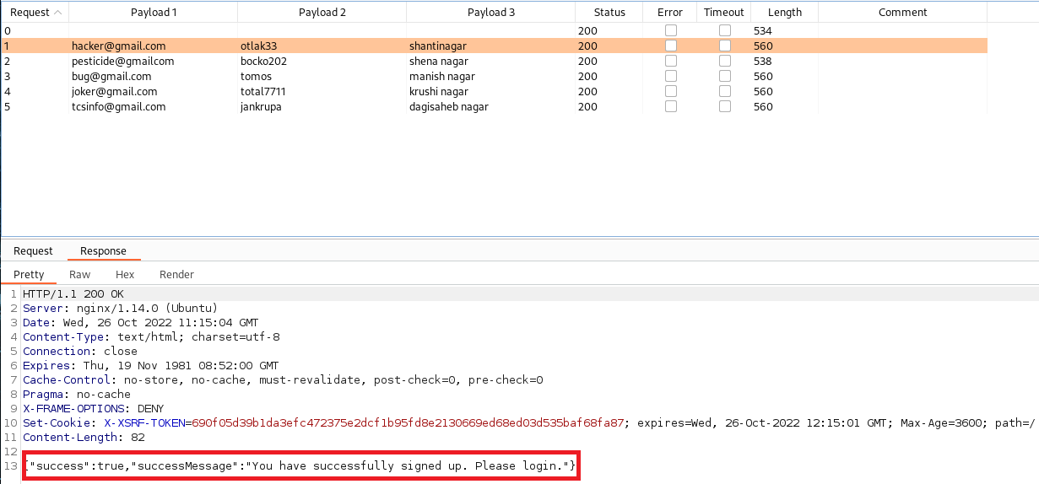
POC
using payload as email, username and address attacker can create multiple users like millions of users
which could cause an immense load website server.

Slide 65
7) Rate Limiting Issues
Account Takeover Using OTP Bypass (Critical) | The below mentioned login page allows login via OTP which can be brute forced. Affected URL : http://13.232.112.210/reset_password/admin.php Affected Parameters : otp (POST parameters)

Slide 66
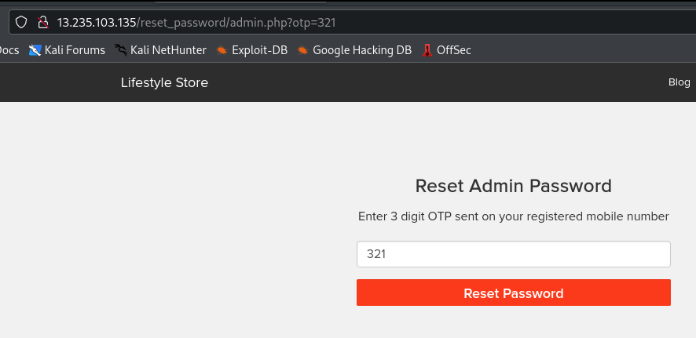
Observation
Navigate to http://13.232.112.210/login/admin.php you will see a “Forgot your password?” hyperlink which asks for OTP which is sent to admin’s phone number, write any 3-digit number (i.e. any number from 100 - 999) and Intercept the request with Burp Suite.

Slide 67
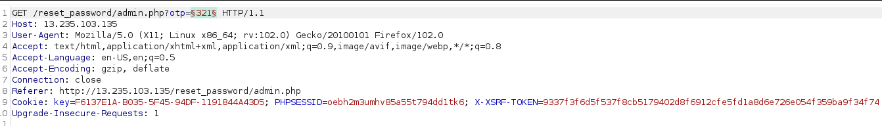
Observation
Following request will be generated containing OTP parameter(GET).

Slide 68
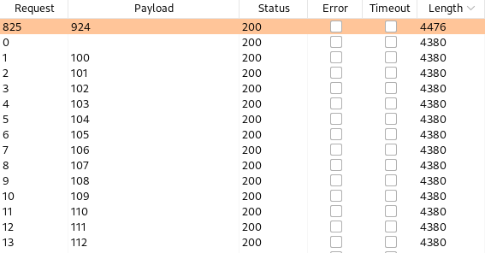
Observation
We shoot the request with all possible combinations of 3 Digit OTPs and upon a successful hit, we get a response containing user details(i.e. the correct OTP). We can use this OTP to reset admin password and then use the new admin password to login as administrator.
OTP for this Session was 924.

Slide 69
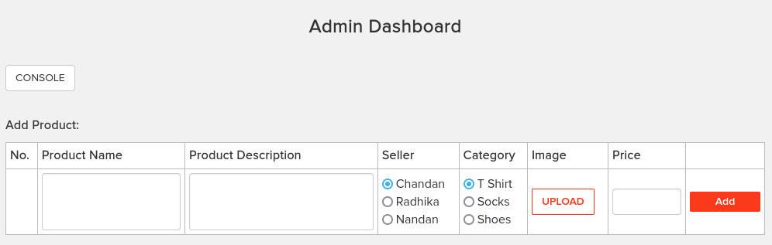
PoC – access to admin dashboard

Slide 70
Business Impact – Extremely High
A Malicious hacker can gain complete access to admin account just by Brute-Forcing due to rate limiting flaw as a hacker can attempt as many times as he wants , as there is no bounds in no of tries. This leads to complete compromise of personal user data of every customer.
Once the attacker logs in as admin, then he can carry out actions on behalf of the victim(admin) which could lead to serious financial loss to him/her, like he can change the name, picture and even price of the products.

Slide 71
Recommendation
Use proper rate-limiting checks on the no of OTP checking and Generation requests.
Implement anti-bot measures such as ReCAPTCHA after multiple incorrect attempts.
OTP should expire after certain amount of time like 2-5 minutes.
OTP should be at least 6 digit and alphanumeric for more security.
Encryption can also used in OTP.

Slide 72
References
https://www.owasp.org/index.php/Testing_Multiple_Factors_Authentication_(OWASP-AT-009)
https://www.owasp.org/index.php/Blocking_Brute_Force_Attacks

Slide 73
8) Insecure file upload
Insecure File Uploads (Critical) | Below mentioned URL is vulnerable to insecure file uploads, Affected URL : http://13.235.103.135/admin31/insert_new_product.php File Uploaded : backdoor shell (mini.b374k.php)

Slide 74
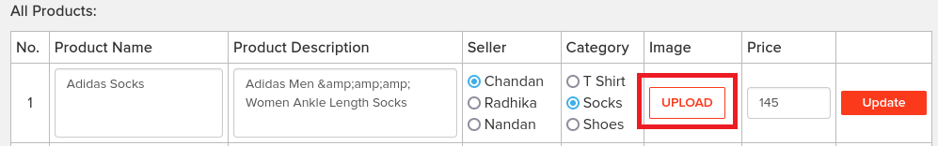
Observation
Login to the admin panel.
Scroll below there you can see edit options of all products
In the image section you can upload an image (png, jpeg)
we can upload php file by changing extension as .png which could work as backdoor
if admin changes its username and password.

Slide 75
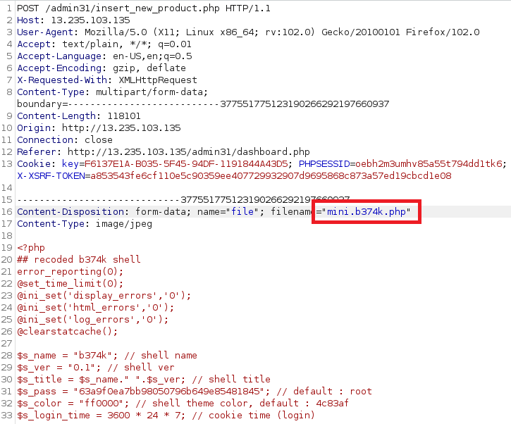
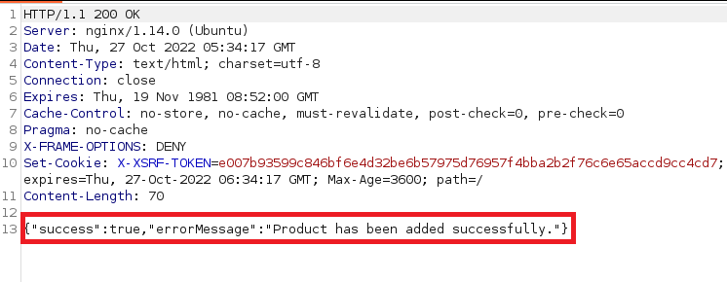
POC - successfull uplaod of file
Intercept the request when you click on upload buttton and then change the request as mini.b374k.png to mini.b374k.php.
forward the request .
In response you can see the successfull upload of file.

Slide 76
Business Impact – Extremely High
since attacker can have an access to admin panel all the time until he removes the backdoor.
so an attacker can do anything to website like edit , remove, add products.

Slide 77
8) Insecure file upload
Insecure File Uploads (Critical) | Below mentioned URL is vulnerable to insecure file uploads, Affected URL : http://13.232.112.210/wondercms/ File Uploaded : backdoor shell (anonymous.php)

Slide 78
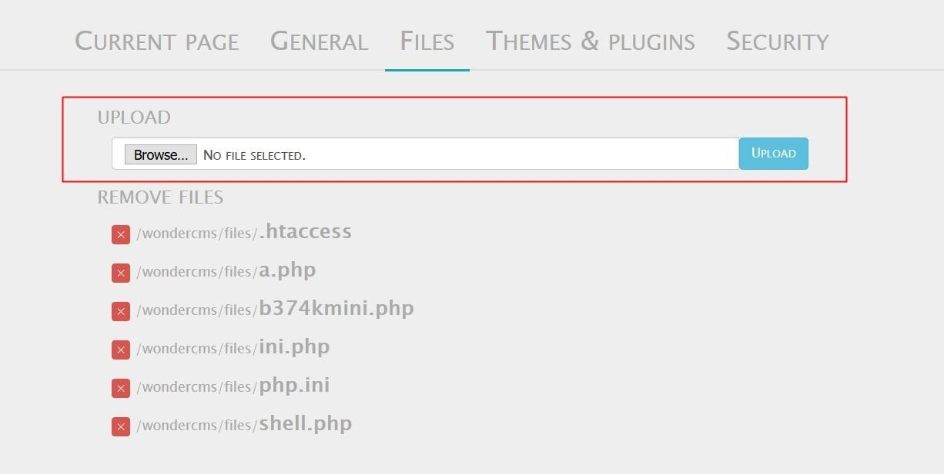
Observation
Navigate to the Blog section of the website and login as admin.
Now, navigate to the Settings and then go to Files option.
You will notice an Upload section here,

Slide 79
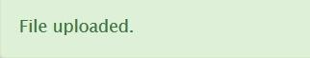
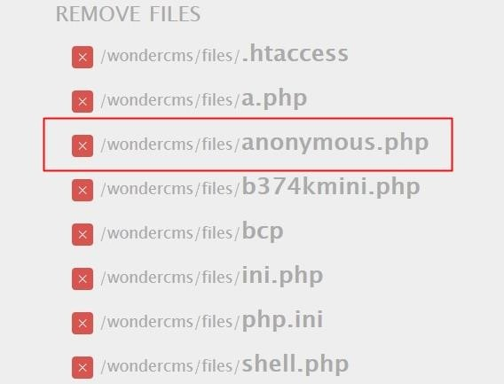
Observation
It looks like we can upload files here, let’s try uploading a file anonymous.php
And it’s successfully uploaded.

Slide 80
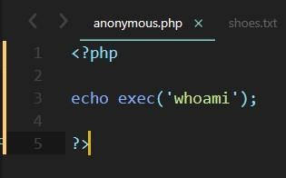
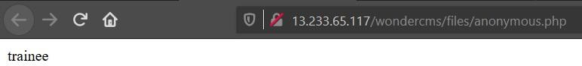
PoC - any command can be executed
Shell – anonymous.php
The uploaded shell was executed successfully.

Slide 81
Business Impact – Extremely High
The consequences of unrestricted file upload can vary:-
including complete system takeover, an overloaded file system or database.
forwarding attacks to back-end systems.
client-side attacks, or simple defacement.
It depends on what the application does with the uploaded file and especially where it is stored.

Slide 82
Recommendation
Take the following precautions:
The file types allowed to be uploaded should be restricted to only those that are necessary for
business functionality.
Never accept a filename and its extension directly without having a whitelist filter.
All the control characters and Unicode and the special characters should be discarded.

Slide 83
References
https://owasp.org/www-community/vulnerabilities/Unrestricted_File_Upload
https://www.hackingarticles.in/comprehensive-guide-on-unrestricted-file-upload/

Slide 84
9) Forced Browsing
Forced Browsing (Severe) | Below mentioned URLs is vulnerable to forced browsing. Affected URL : http://13.235.103.135/ Forced URLs : http://13.235.103.135/admin31/dashboard.php http://13.127.150.195/admin31/console.php

Slide 85


Observation
As a customer, Login to your account.
Now, forcefully type in the url for going to the admin dashboard http://13.235.103.135/admin31/dashboard.php .

Slide 86

PoC – admin dashboard access
Here is the access to the complete admin dashboard just by entering its complete url.

Slide 87

PoC – admin console access
Here is the access to the admin console just by entering its complete url.

Slide 88
Business Impact – Severe
Attacker can have all the admin privileges.
He can edit all the items.
He can execute any harmful command through console.

Slide 89
Recommendation
Server side security checks should be performed perfectly.
Make the admin page url complicated so that it couldn’t be guessed.

Slide 90
References
https://owasp.org/www-community/attacks/Forced_browsing

Slide 91
10) Descriptive Error Messages
Descriptive Error Messages (Low) | Below mentioned URLs shows descriptive error messages, Affected URL: http://13.232.112.210/?includelang=lang/en.php Affected Parameter: includelang

Slide 92

Observations
Navigate to the website and click on change language dropdown, and select any of the two languages.
Now, notice the URL, you get a ‘get’ parameter of includelang which shows descriptive error
messages.
Here, we enter the payload: includelang=’ and on executing this file the page throws a descriptive error.

Slide 93

PoC – descriptive error message displayed

Slide 94
Business Impact – Low
It doesn’t harm the website directly, but it is letting the hacker to know about the website architecture which the hacker can to dig out internal resources and use them against the organization.

Slide 95
Recommendation
Developers should turn off this descriptive error messages before the web application is
finally released for general public use.

Slide 96
References
https://owasp.org/www-community/Improper_Error_Handling

Slide 97
11) Remote File Inclusion
Remote File Inclusion (Critical) | Below mentioned URL is vulnerable to RFI. Affected URL : http://13.232.112.210/?includelang=lang/en.php Affected Parameters : https://www.google.com (/?includelang=here)

Slide 98

Observations
Navigate to the website and click on change language dropdown, and select any of the two languages.
Now, notice the URL, you get a ‘GET’ parameter of includelang which is vulnerable to file inclusion.
Here, we enter the payload: includelang=https://google.com and on executing this gives us the google search page.

Slide 99

PoC - attacker can upload shells
Attacker can exploit the referencing function in an application to upload malware (e.g., backdoor shells) from a remote URL located within a different domain.

Slide 100
Business Impact – Extremely High
Any attacker can have the root access of your website.
He can execute commands.
Through the website, he can have access of the server and can infect other websites hosted on that server.

Slide 101
Recommendation
To safely parse user-supplied filenames it’s much better to maintain a whitelist of
acceptable filenames.
Use a corresponding identifier (not the actual name) to access the file. Any request containing an invalid identifier can then simply be rejected(this is the approach that OWASP recommends).

Slide 102
References
https://en.wikipedia.org/wiki/File_inclusion_vulnerability
https://owasp.org/www-project-web-security-testing-guide/v42/4-Web_Application_Security_Testing/07-Input_Validation_Testing/11.2-Testing_for_Remote_File_Inclusion

Slide 103
12) Default Files and Pages
Default Files and Pages (Low) | Below mentioned URLs shows default files and pages. Affected URL: http://13.232.112.210/ Default files and pages present: server-status robots.txt userlist.txt phpinfo.php composer.json

Slide 104

PoC – server-status

Slide 105

PoC – robots.txt

Slide 106

PoC – userlist.txt

Slide 107

PoC – phpinfo.php

Slide 108

PoC – composer.json

Slide 109
Business Impact – Low
It doesn’t harm the website directly, but it is letting the hacker collect more internal information about the website which the hacker might use against the organization.

Slide 110
Recommendation
Developers should disable all default files and pages to be displayed publicly.

Slide 111
References
https://www.indusface.com/blog/owasp-security-misconfiguration/
https://hdivsecurity.com/owasp-security-misconfiguration

Slide 112
13) Components with Known Vulnerabilities
Components with Known Vulnerabilities (Critical) | Below mentioned URL contains components with known vulnerabilities. Affected URL: http://13.232.125.26/wondercms/ http://13.232.125.26/forum/ and the PHP Version.

Slide 113


Observation
The php version of this website is 5.6.39-1 which is Out Dated.
Latest php version is 8.0

Slide 114




Observation
Upon checking the versions of these components they turned out to be Out Dated.
Versions being used,
Latest versions are available

Slide 115

PoC
Wondercms 2.3.1 has public exploits.

Slide 116

PoC
Codoforum has public exploits.

Slide 117
Business Impact – Extremely High
Anyone can perform any attacks (available) as all the exploits are available publicly .
It can cause severe damage to the website
He may be able to upload backdoor shells
He will easily deface your website

Slide 118
Recommendation
Update all the components and the php version which is running on it.
Hide the current versions info from there pages.

Slide 119
References
https://owasp.org/www-project-top-ten/OWASP_Top_Ten_2017/Top_10-2017_A9-
Using_Components_with_Known_Vulnerabilities
https://www.cvedetails.com/vulnerability-list/vendor_id-15088/product_id-30715/version_id-
235577/Wondercms-Wondercms-2.3.1.html
https://www.cvedetails.com/vulnerability-list/vendor_id-15315/Codoforum.html

Slide 120
14) Bruteforce Exploitation of Coupon Codes
Bruteforce Exploitation (Severe) | Below mentioned URL is vulnerable to brute forcing and can be exploited for discounts. Affected URL : http://13.232.125.26/cart/apply_coupon.php

Slide 121

Observation
Upon adding items to the cart, you will end up in a screen like this, where we see the apply coupon section and an example.
Type in UL_6666 in the apply coupon section and intercept the request using Burp Suite.

Slide 122

Observation
Following request will be generated containing coupon code.

Slide 123

Observation
We shoot the request with all possible combinations of 4 Digit numbers and upon a successful hit, we get a response containing the valid coupon code. We can use this code to get the discount.
Valid coupon code for this website is UL_1247, UL_2566, UL_1056

Slide 124

PoC – coupon code applied successfully

Slide 125
Business Impact – Severe
Attacker can easily order the items on extreme discounts which in turn will cause huge loss to the company.

Slide 126
Recommendation
Coupon codes should have limited number of uses and should be regenerated after sometime.
Coupon code should be random alpha-numeric characters.

Slide 127
Reference
https://www.trustwave.com/en-us/resources/blogs/spiderlabs-blog/hacking-online-coupons/
https://www.couponxoo.com/brute-force-attack-coupon-code

Slide 128
15) Command execution Vulnerability
Command Execution Vulnerability (Critical) | Below mentioned URLs is vulnerable to command execution, Affected URLs : http://13.232.125.26/wondercms/files/b374kmini.php http://13.127.150.195/admin31/console.php

Slide 129

Observation
Navigate to the Blog section of the website and login as admin.
Now, navigate to the Settings and then go to Files option.
You will notice an Remove Files section here, click on /wondercms/files/b374kmini.php

Slide 130

Observation
It looks like, this is a small and simple PHP-shell that has an explorer, allows shell command execution, mysql
queries, and more.

Slide 131


PoC – command execution
Type in the Command: ls and press Go!
The command was executed successfully.

Slide 132

Observation
As a customer, Login to your account.
Now, forcefully type in the url for going to the admin console http://13.127.150.195/admin31/console.php (you came to know about this url while testing vulnerabilities for Vulnerability Report No. 7, Rate Limiting Flaws), and press enter.

Slide 133


PoC – command execution
It seems like we can execute commands here, let’s try by typing ls and press SUBMIT!
The command was executed successfully.

Slide 134
Business Impact – Extremely High
The consequences of command execution can vary:-
including complete system takeover, an overloaded file system or database.
forwarding attacks to back-end systems.
client-side attacks, or simple defacement.

Slide 135
Recommendation
Hide all files in the Upload Screen.
Delete all php shells.

Slide 136
References
https://miniphpshell.wordpress.com/2009/10/13/b374k-mini-shell/
https://owasp.org/www-community/attacks/Command_Injection

Slide 137
16) Cross-Site Request Forgery
Cross-Site Request Forgery (Severe) | Below mentioned URLs are vulnerable to cross-site request forgery. Affected URLs : http://13.232.125.26/profile/change_password.php http://13.233.24.9/cart/cart.php

Slide 138

Observation
As a customer, Login to your account.
Go to My Profile section and click on Change Password button, a change password page appears.
we can forge the requestv by creating a HTML page.

Slide 139

PoC – password changed successfully
Now, make a HTML page to update/change your password.
Type in a new set of password and click on Submit button, upon clicking on it, we get a Success Message.
Now, logout and try to login again with your new password, you will be logged in successfully.

Slide 140

Observation
As a customer, Login to your account.
Shop any product and add it to your cart.
we can confirm this order without directly pressing on the CONFIRM ORDER button on this page by creating a HTML page.

Slide 141

PoC – order confirmed successfully
Now, make a HTML page to confirm your order.

Slide 142

PoC – order confirmed successfully
Just click on Confirm Order button in our HTML page, and the order confirmation page will load in the same window.

Slide 143
Business Impact – Severe
Attacker can change the password by uploading phishing pages and take complete control of the user account and use it to plan further attacks on the company.
Attacker can confirm the order without consent of user which in turn can lead to a huge loss for the
company.

Slide 144
Recommendation
Use tokens and session cookies.
Ask the user his password (temporary like OTP or permanent like login password) at every
critical action like while deleting account, making a transaction, changing the password etc.
Implement the concept of CSRF tokens which attach a unique hidden password to every user in every <form>. Read the documentation related to the programming language and framework being used by your website
Check the referrer before carrying out actions. This means that any action on x.com should check that the HTTP referrer is https://x.com/* and nothing else like https://x.com.hacker.com/*

Slide 145
References
https://owasp.org/www-community/attacks/csrf
https://en.wikipedia.org/wiki/Cross-site_request_forgery
https://portswigger.net/web-security/csrf

Slide 146
17) weak password
Default Admin Password (Critical) | Below mentioned URL is using default admin credentials. Affected URL: http://13.232.125.26/ovidentiaCMS/index.php?tg=login&cmd=authform&msg=Connexion&err=&restricted=1 Component Name: ovidentia content management system

Slide 147

Observation
Navigate to http://13.232.125.26/ovidentiaCMS/
In the ovidentia CMS page there is option called Connexion to login as admin.
Upon clicking it we can see this page,

Slide 148

PoC - ovidentia CMS admin access
On searching for default ovidentia CMS admin credentials on the web we got,

Slide 149

PoC
Upon entering the credentials we got the administrator access.

Slide 150
Business Impact – Extremely High
Attacker will have all the admin privileges.
He can easily deface the ovidentia CMS.

Slide 151
Recommendation
Two- Factor Authentication for sensitive data should be added with strong passwords.
Disable the default debug pages.
Hide the admin login page.
Remove all the default passwords and add your own password which should be very strong. It must contain a special character, at least one lowercase letter, at least one uppercase letter, and a number and it must be greater than or equal to 8 digits for maximum security.

Slide 152
References
https://www.indusface.com/blog/owasp-security-misconfiguration/
https://owasp.org/www-project-web-security-testing-guide/latest/4-Web_Application_Security_Testing/04-Authentication_Testing/07-Testing_for_Weak_Password_Policy

Slide 153
thank you
For any further clarifications/patch assistance, please contact:
saurabhcoc03@gmail.com

